Slide 1
DTS207TC Database Development and Design
Lecture 12
Chap 31. Information Retrieval
Di Zhang, Autumn 2025
Notes:
I am very happy to have the opportunity to meet with you all in this course.

Slide 2
Outline
History
IF-IDF
Pagerank
Revert-Index
Web Crawler

Slide 3

The History of Search Engines
The Early Days: Pre-Web & The First Steps
Before Google: The Pioneers (1990-1995)
The Problem: The early internet was a collection of disconnected files. No easy way to find anything.
Archie (1990): The first "search engine." It simply indexed the names of files on public FTP servers.
Gopher & Veronica/Jughead: Searched menu-based systems, not full text.
The Web Explosion: The invention of the World Wide Web (WWW) created a urgent need for better navigation tools.
Wandex (1993): The first web robot and indexer, cataloging the early web.

Slide 4
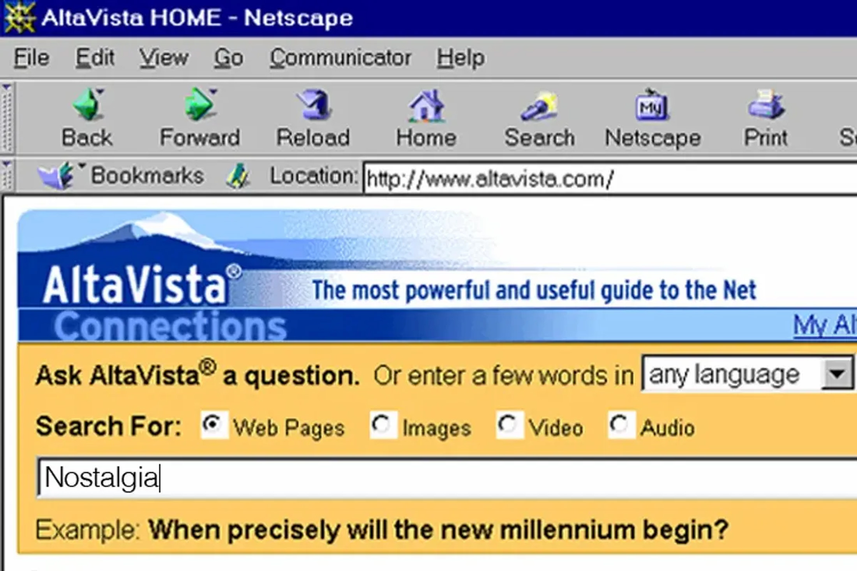
The Rise of Web Crawlers & The First Giants
The Crawler Revolution (1994-1998)
WebCrawler (1994): The first full-text search engine that allowed users to search for any word on any webpage.
The Directory Approach - Yahoo!: Founded by humans who manually categorized websites. It was a curated web directory, not a true crawler-based engine.
The Powerhouses: AltaVista & Excite:
AltaVista: Launched by DEC, it was fast, powerful, and supported natural language queries and advanced search operators. It was the king of search for years.
The Common Flaw: These early engines relied heavily on basic keyword matching, making them easy to spam with irrelevant pages.

Slide 5
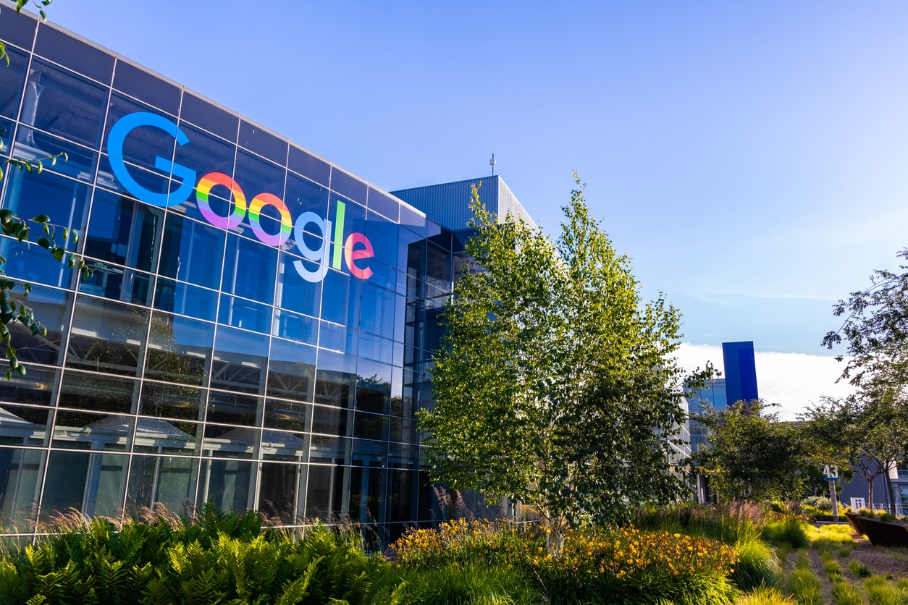
The Google Revolution: PageRank Changes Everything
The Game Changer: Google (1998-Present)
The Breakthrough: PageRank Algorithm.
Founded by Larry Page and Sergey Brin at Stanford.
Core Idea: A webpage is important if other important pages link to it. It treated links as "votes."
Why It Won:
Relevance: Delivered vastly more relevant and higher-quality results.
Speed: Incredibly fast.
Simplicity: The clean, uncluttered homepage was a stark contrast to the "portal" look of competitors.
The Domination: Google's superior technology quickly made it the default search engine for the world.

Slide 6
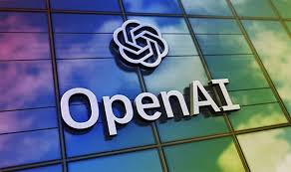

The Modern Era & The AI-Powered Future
Beyond Keywords: Voice, Personalization, and AI
Mobile & Voice Search: Search moved from the desktop to everywhere. Queries became conversational ("OK Google, where's the nearest coffee shop?").
Personalization: Search results are tailored to your location, search history, and preferences.
Featured Snippets & "Answer Engines": Google started pulling information directly to the top of the page, aiming to answer your question without a click.
The AI & LLM Revolution (Now & Future):
BERT & MUM: Google's AI models understand context and nuance in queries like never before.
Generative AI & ChatGPT: The rise of Large Language Models (LLMs) is shifting search from a "list of links" to a conversational experience. The future is about getting synthesized, direct answers and engaging in a dialogue.

Slide 7
Information Retrieval Systems
Information retrieval (IR) systems use a simpler data model than database systems
Information organized as a collection of documents
Documents are unstructured, no schema
Information retrieval locates relevant documents, on the basis of user input such as keywords or example documents
e.g., find documents containing the words “database systems”
Can be used even on textual descriptions provided with non-textual data such as images
Web search engines are the most familiar example of IR systems

Slide 8
Information Retrieval Systems (Cont.)
Differences from database systems
IR systems don’t deal with transactional updates (including concurrency control and recovery)
Database systems deal with structured data, with schemas that define the data organization
IR systems deal with some querying issues not generally addressed by database systems
Approximate searching by keywords
Ranking of retrieved answers by estimated degree of relevance

Slide 9
Keyword Search
In full text retrieval, all the words in each document are considered to be keywords.
We use the word term to refer to the words in a document
Information-retrieval systems typically allow query expressions formed using keywords and the logical connectives and, or, and not
Ands are implicit, even if not explicitly specified
Ranking of documents on the basis of estimated relevance to a query is critical
Relevance ranking is based on factors such as
Term frequency
Frequency of occurrence of query keyword in document
Inverse document frequency
How many documents the query keyword occurs in
Fewer ➔ give more importance to keyword
Hyperlinks to documents
More links to a document ➔ document is more important

Slide 10
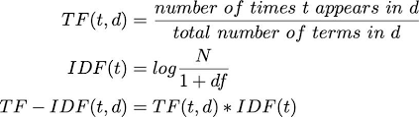
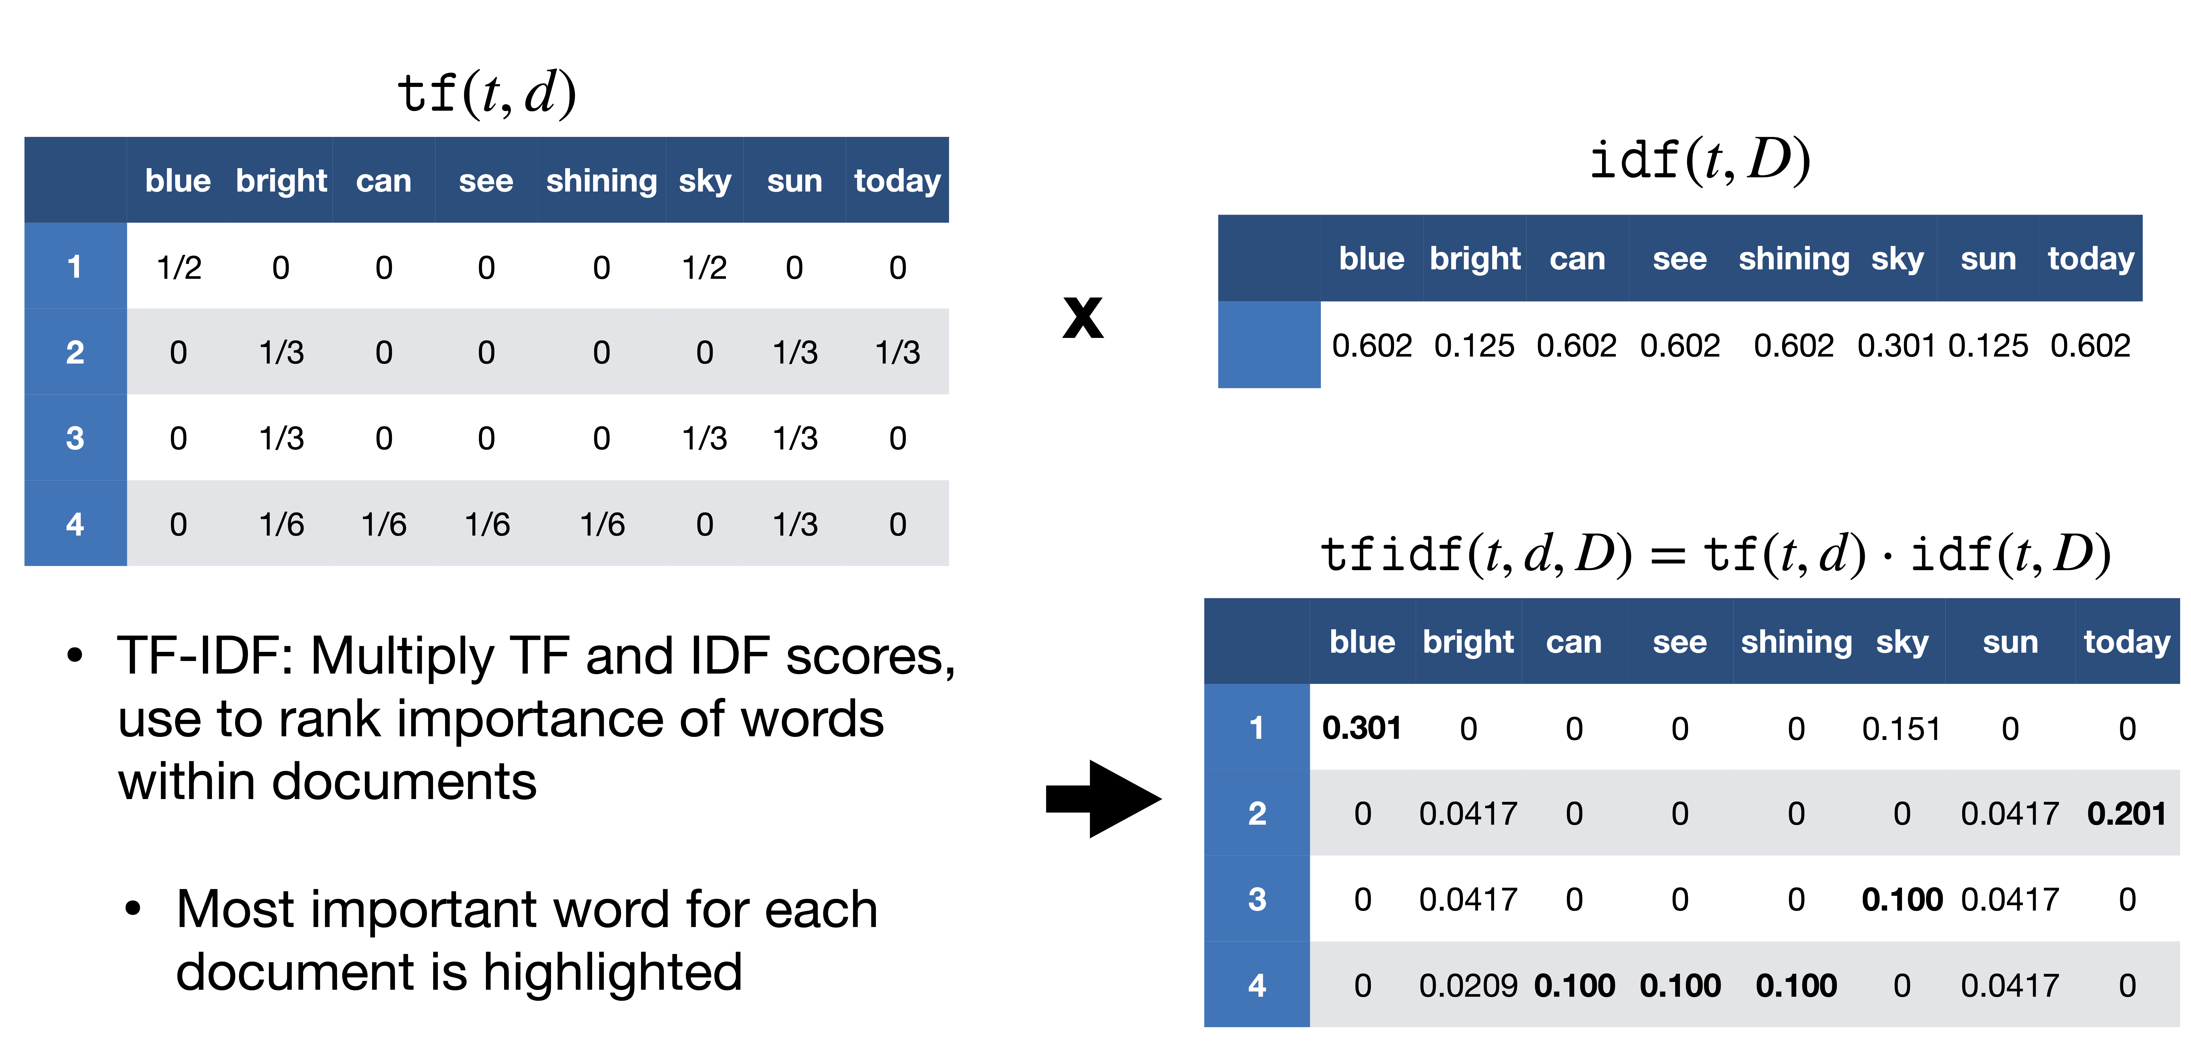
Relevance Ranking Using Terms
TF-IDF (Term frequency/Inverse Document frequency) ranking:

Slide 11
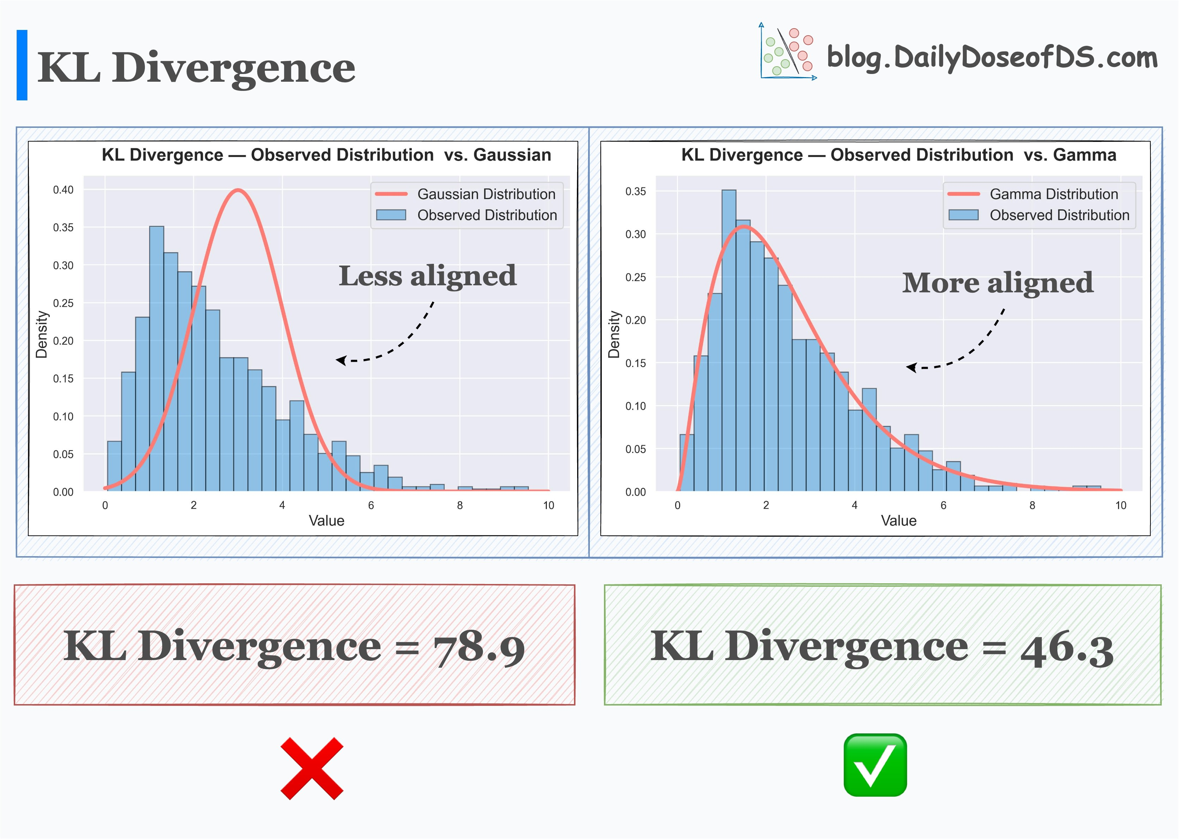
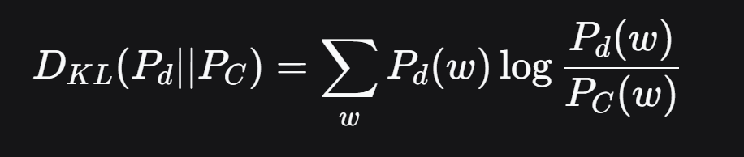
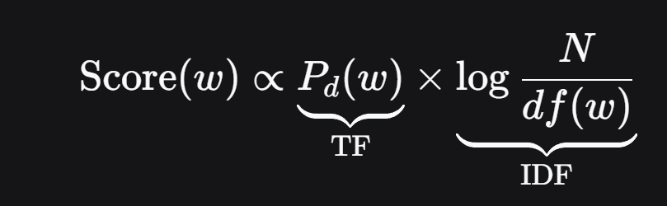
TF-IDF is the measure of importance in information theory*
The Goal:
Find term weights that make each document stand out from the corpus average.
The Math:
We model this by maximizing the difference between:
A term's local distribution in a doc, P(t|d) (≈ TF)
Its global background distribution, P(t)
The Insight:
The optimal measure for this difference is KL Divergence:

Slide 12
Relevance Ranking Using Terms (Cont.)
Most systems add to the above model
Words that occur in title, author list, section headings, etc. are given greater importance
Words whose first occurrence is late in the document are given lower importance
Very common words such as “a”, “an”, “the”, “it” etc. are eliminated
Called stop words
Proximity: if keywords in query occur close together in the document, the document has higher importance than if they occur far apart
Documents are returned in decreasing order of relevance score
Usually only top few documents are returned, not all

Slide 13
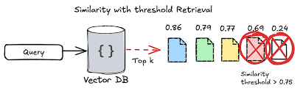
Similarity Based Retrieval
Similarity based retrieval - retrieve documents similar to a given document
Similarity may be defined on the basis of common words
E.g., find k terms in A with highest TF (d, t ) / n (t ) and use these terms to find relevance of other documents.
Relevance feedback: Similarity can be used to refine answer set to keyword query
User selects a few relevant documents from those retrieved by keyword query, and system finds other documents similar to these
Vector space model: define an n-dimensional space, where n is the number of words in the document set.
Vector for document d goes from origin to a point whose i ^{th} coordinate is TF (d,t ) / n (t )
The cosine of the angle between the vectors of two documents is used as a measure of their similarity.

Slide 14
Relevance Using Hyperlinks
Number of documents relevant to a query can be enormous if only term frequencies are taken into account
Using term frequencies makes “spamming” easy
E.g., a travel agency can add many occurrences of the words “travel” to its page to make its rank very high
Most of the time people are looking for pages from popular sites
Idea: use popularity of Web site (e.g., how many people visit it) to rank site pages that match given keywords
Problem: hard to find actual popularity of site
Solution: next slide

Slide 15
Relevance Using Hyperlinks (Cont.)
Solution: use number of hyperlinks to a site as a measure of the popularity or prestige of the site
Count only one hyperlink from each site (why? - see previous slide)
Popularity measure is for site, not for individual page
But, most hyperlinks are to root of site
Also, concept of “site” difficult to define since a URL prefix like cs.yale.edu contains many unrelated pages of varying popularity
Refinements
When computing prestige based on links to a site, give more weight to links from sites that themselves have higher prestige
Definition is circular
Set up and solve system of simultaneous linear equations
Above idea is basis of the Google PageRank ranking mechanism

Slide 16
Relevance Using Hyperlinks (Cont.)
Connections to social networking theories that ranked prestige of people
E.g., the president of the U.S.A has a high prestige since many people know him
Someone known by multiple prestigious people has high prestige
Hub and authority based ranking
A hub is a page that stores links to many pages (on a topic)
An authority is a page that contains actual information on a topic
Each page gets a hub prestige based on prestige of authorities that it points to
Each page gets an authority prestige based on prestige of hubs that point to it
Again, prestige definitions are cyclic, and can be got by solving linear equations
Use authority prestige when ranking answers to a query

Slide 17
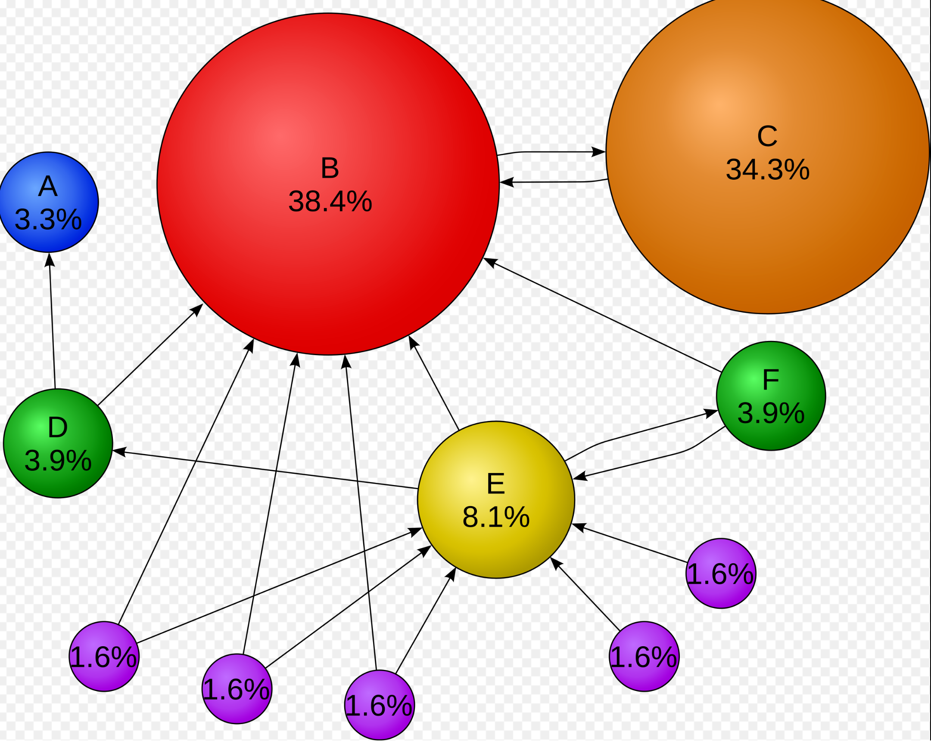
Introduction to PageRank
What is PageRank?
A link analysis algorithm developed by Google founders Larry Page and Sergey Brin at Stanford.
Core Idea: A web page is important if it is linked to by other important pages.
It assigns a numerical weight to each element of a hyperlinked set of documents (like the World Wide Web) to measure its relative importance.
Originally the foundation of Google's web search ranking.
The Intuition: The "Random Surfer" Model
Imagine a person randomly clicking on links.
The PageRank value represents the probability that this random surfer will land on a given page.
A page has a high rank if:
Many pages link to it.
Important pages link to it.

Slide 18
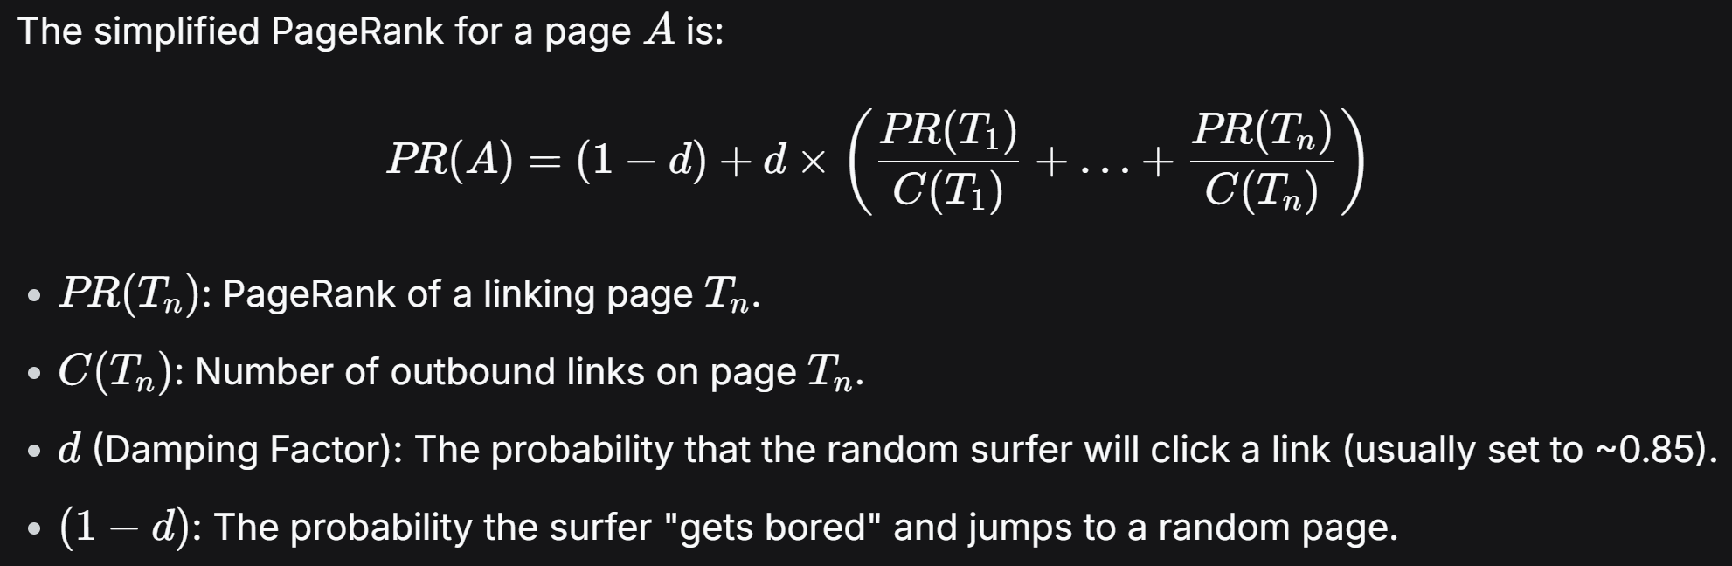
How PageRank Works - The Math
The Basic Formula:
It's a "Chicken and Egg" Problem:
To know A's rank, you need to know the rank of all pages linking to A.
This creates a system of equations that must be solved simultaneously.

Slide 19
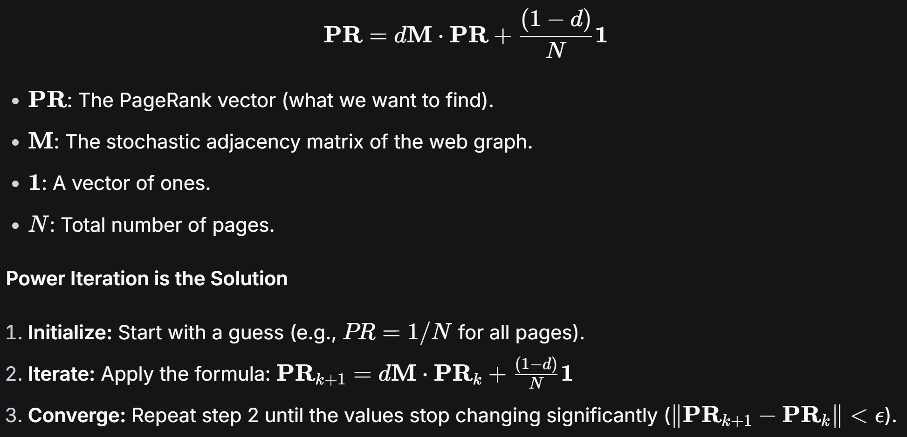
The Power Iteration Connection*
The entire web's PageRank can be represented as an eigenvector problem.
Why it Works:
Power Iteration is a numerical method for finding the dominant eigenvector of a matrix.
The PageRank vector is the dominant eigenvector of the modified web matrix.
This makes the computation scalable to billions of web pages.

Slide 20
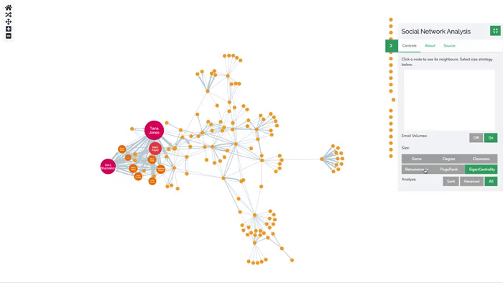
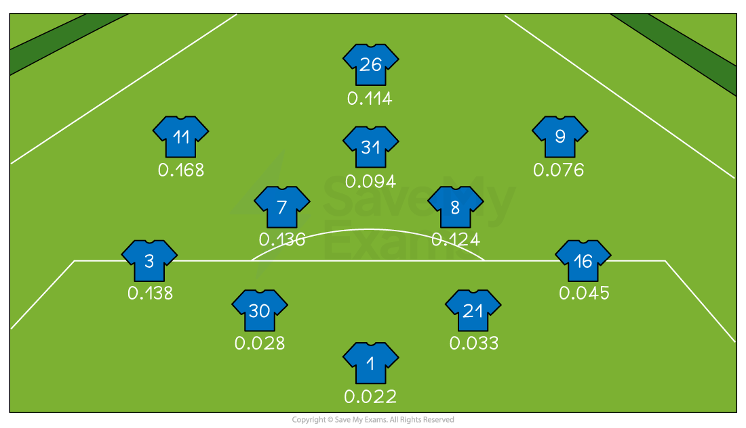
Beyond Web Search - Applications
Social Network Analysis
Identifying Influencers: PageRank can identify key influencers in a social graph. A user is "important" if they are followed by other important users.
Recommendation Systems: It can rank users or content. For example, on Twitter/X, a user's "Who to Follow" suggestions can be based on a PageRank-like score.
Fraud Detection: In a network of financial transactions, PageRank can help identify accounts that are central to suspicious activity.
Other Domain Applications
Bioinformatics: Ranking proteins in a protein-protein interaction network to find the most critical ones.
Neuroscience: Identifying key regions in a brain connectivity network.
Citation Analysis: Determining the importance of academic papers based on which other papers cite them (the original "Impact Factor" idea).
Any System that can be Modeled as a Graph: Where the importance of a node depends on the importance of its neighbors.

Slide 21
The Inverted Index: Powering Modern Search
What is the Problem?
We have a massive collection of documents (web pages, articles, books).
A user queries for a specific word or phrase.
How do we quickly find all documents containing that term without scanning every single document?
The Answer: The Inverted Index
A data structure that maps words to the list of documents they appear in.
Think of it as the "index" at the back of a book, but for an entire corpus.
Analogy: A Book's Index
You don't read the entire book to find a topic.
You look up the topic in the index, which points you to the relevant pages.

Slide 22
Structure of an Inverted Index
A Simple Example:
We have three documents:
Doc1: "the cat sat on the mat"
Doc2: "the dog played with the cat"
Doc3: "the mat is clean"
Forward Lookup (Inefficient):
Document | Content
Doc1 | the cat sat on the mat
Doc2 | the dog played with the cat
Doc3 | the mat is clean

Slide 23
Inverted Index (Efficient):
Key Components:
Dictionary/Terms: The unique words (e.g., "cat", "mat").
Posting List: The list of documents where the term appears.
Additional Data (Optional): Term frequency, positions (for phrase queries), etc.
Term | Posting List (Document ID : Positions)
cat | Doc1: [2], Doc2: [6]
dog | Doc2: [3]
mat | Doc1: [6], Doc3: [2]
sat | Doc1: [3]
the | Doc1: [1, 5], Doc2: [1, 5], Doc3: [1]
... | ...

Slide 24
Building an Index with MapReduce
The Challenge:
Building an index for the entire web is impossible on a single machine. We need a distributed approach.
Why MapReduce?
Automatic Parallelization: Splits the work across thousands of machines.
Fault Tolerance: Handles machine failures gracefully.
Ideal for this task: The process is inherently parallelizable.
High-Level Process:
Input: A large set of raw text documents stored in a distributed file system (e.g., HDFS).
MapReduce Phases:
Map: Processes each document and emits (key, value) pairs.
Shuffle & Sort: Groups all values (intermediate data) by the same key.
Reduce: Aggregates the grouped data to form the final index.

Slide 25

Demo

Slide 26
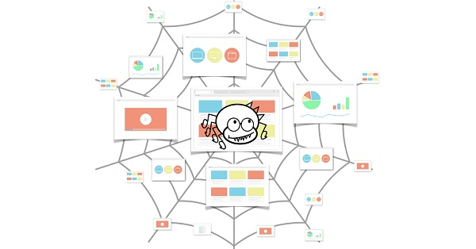
Web Crawling
Web crawlers systematically browse the web to collect data.
Underlying data structures determine efficiency, scalability, and correctness.

Slide 27
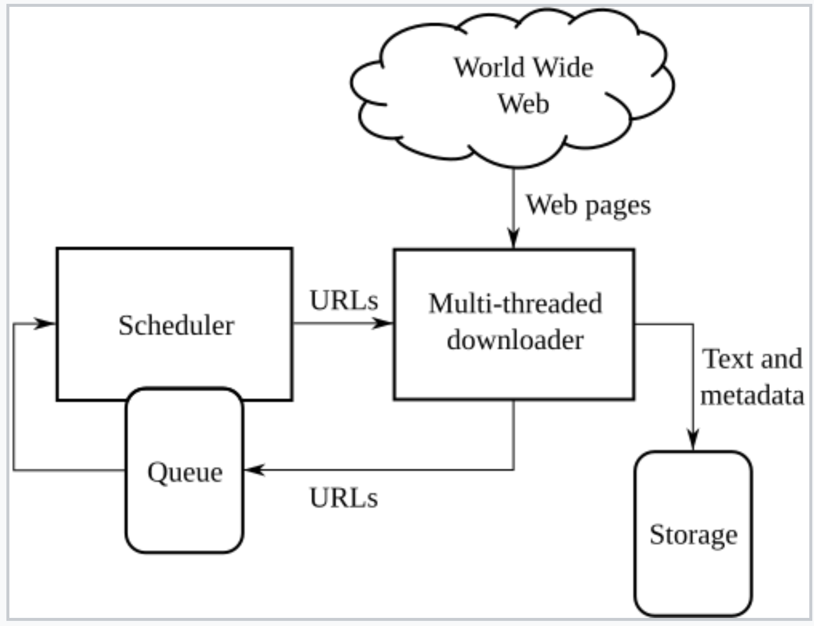
Architecture

Slide 28
Example
https://www.octoparse.com/
https://www.youtube.com/watch?v=F6CEXNb54TI

